Slide 1
Murach’s Modern JavaScript
Chapter 14
How to work with Ajax

Slide 2
Objectives
Applied
Use your browser to make a GET request to a web service.
Use the Fetch API to make GET, POST, PUT, and DELETE requests that update a web page without reloading it.
Use the async and await keywords to work with asynchronous functions.
Use an API for a web service to get data from a website.
Use a server-side proxy to get data from a web service that doesn’t allow cross-origin requests.
Knowledge
In general terms, describe how Ajax works.
Distinguish between XML and JSON.
Name and describe the three states of a Promise object.

Slide 3
Objectives (continued)
Knowledge
Describe how a callback function works and why callback functions are essential to asynchronous programming.
Describe how a top-level await works.

Slide 4
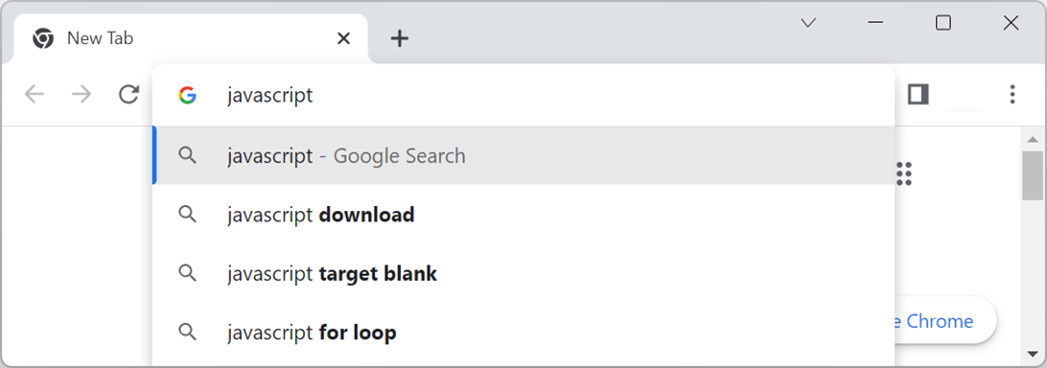
Google’s Auto Suggest uses Ajax

Slide 5
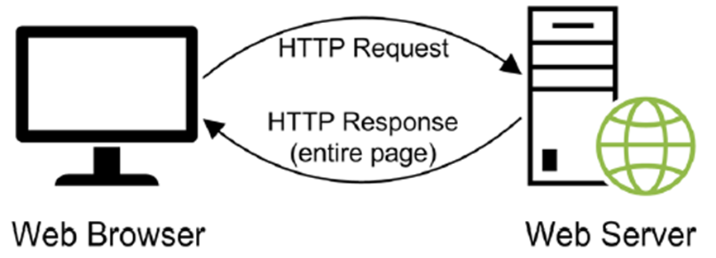
A normal HTTP request

Slide 6
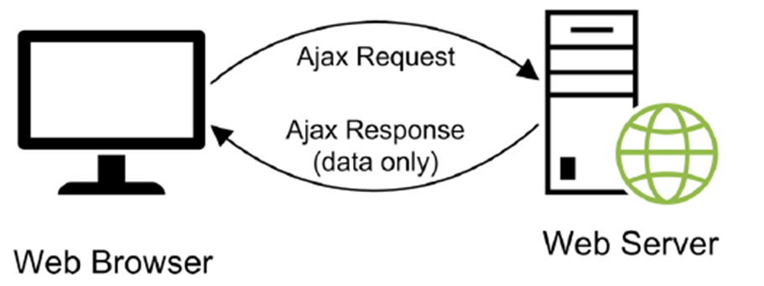
An Ajax request

Slide 7
Two common data formats used with Ajax
XML
JSON

Slide 8
Data formatted with XML
<?xml version="1.0" encoding="utf-8"?>
<management>
<teammember>
<name>Wilber</name>
<title>Vice President of Accounting</title>
<bio>With over 14 years of public accounting ...
</bio>
</teammember>
<teammember>
<name>Agnes</name>
<title>Founder and CEO</title>
<bio>While Agnes is the founder and CEO ...
</bio>
</teammember>
</management>

Slide 9
The same data formatted with JSON
{"teammembers":[
{
"name":"Wilbur",
"title":"Vice President of Accounting",
"bio":"With over 14 years of public accounting... "
},
{
"name":"Agnes",
"title":"Founder and CEO",
"bio":"While Agnes is the founder and CEO ... "
}
]}

Slide 10
The JSON Placeholder web service
https://jsonplaceholder.typicode.com
Sample data that’s available from this web service
/users
/posts
/comments
/albums
/photos
/todos

Slide 11
A URL that returns data for all users
https://jsonplaceholder.typicode.com/users
Some of the JSON that’s returned
[
{
"id": 1,
"name": "Leanne Graham",
"username": "Bret",
"email": "Sincere@april.biz",
...
},
...
{
"id": 10,
"name": "Clementina DuBuque",
"username": "Moriah.Stanton",
"email": "Rey.Padberg@karina.biz",
...
}
]

Slide 12
Synchronous vs. asynchronous code
Synchronous code executes statements in sequential order and waits for each statement to finish executing before it begins executing the next one.
Asynchronous code allows an app to continue executing the statements for one operation while waiting for another operation to complete.

Slide 13
One method of the Fetch API
fetch(url, options)
Three states of a Promise object
Pending: After a promise has been created but before the request returns its value.
Fulfilled: When the request is successfully resolved.
Rejected: If an error occurs during the request.
Two methods of the Promise object
then(function)
catch(function)
One method of the Response object
json()

Slide 14
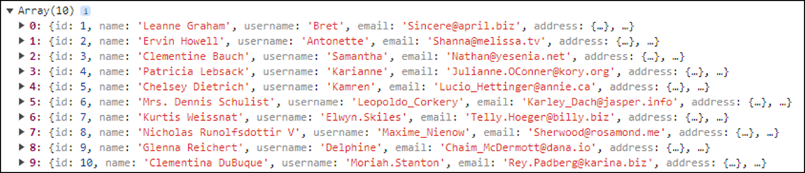
Use a GET request to display user data
const url = "https://jsonplaceholder.typicode.com/users";
fetch(url) // no options, so defaults to GET
.then(response => response.json())
.then(json => console.log(json))
.catch(e => console.log(e.message));
The console

Slide 15
Three common HTTP request methods
Method | Typical use
POST | Adds a new record.
PUT | Updates an existing record.
DELETE | Deletes a record.

Slide 16
Use a POST request to add a new blog post
const title = getElement("#title").value;
const body = getElement("#body").value;
const userId = getElement("#user_id").value;
const options = {
method: 'POST',
headers: {
'Content-type': 'application/json; charset=UTF-8',
},
body: JSON.stringify({title, body, userId})
};
const url = "https://jsonplaceholder.typicode.com/posts";
fetch(url, options)
.then(response => response.json())
.then(json => console.log(json))
.catch(e => console.log(e.message));

Slide 17
Use a DELETE request to delete a blog post
const postId = getElement("#post_id").value;
const url = "https://jsonplaceholder.typicode.com/posts/"
+ postId
fetch(url, {method: 'DELETE'})
.then(response => response.json())
.then(json => console.log(json))
.catch(e => console.log(e.message));

Slide 18
An asynchronous function that uses await
async function loadPhoto(photoId) { // as asynchronous
const domain =
"https://jsonplaceholder.typicode.com";
const photoResponse = await
fetch(`${domain}/photos/${photoId}`);
const photo = await photoResponse.json();
const albumResponse = await
fetch(`${domain}/albums/${photo.albumId}`)
photo.album = await albumResponse.json();
return photo; // automatically wraps
// value in a promise
}

Slide 19
An asynchronous event handler that calls the asynchronous function
getElement("#show_photo").addEventListener(
"click", async () => {
try {
const photo = await loadPhoto(1);
console.log("Photo title: " + photo.title);
console.log("Album title: " + photo.album.title);
} catch(e) {
console.log(e.message);
}
});

Slide 20
Two static methods of the Promise object
resolve(value)
reject(value)
The asynchronous function updated to validate the data it receives
async function loadPhoto(photoId) {
if (photoId < 0 || photoId > 5000) {
const e = new Error(
"Photo id must be between 1 and 5000.");
return Promise.reject(e);
} else {
// same as above
}
}

Slide 21
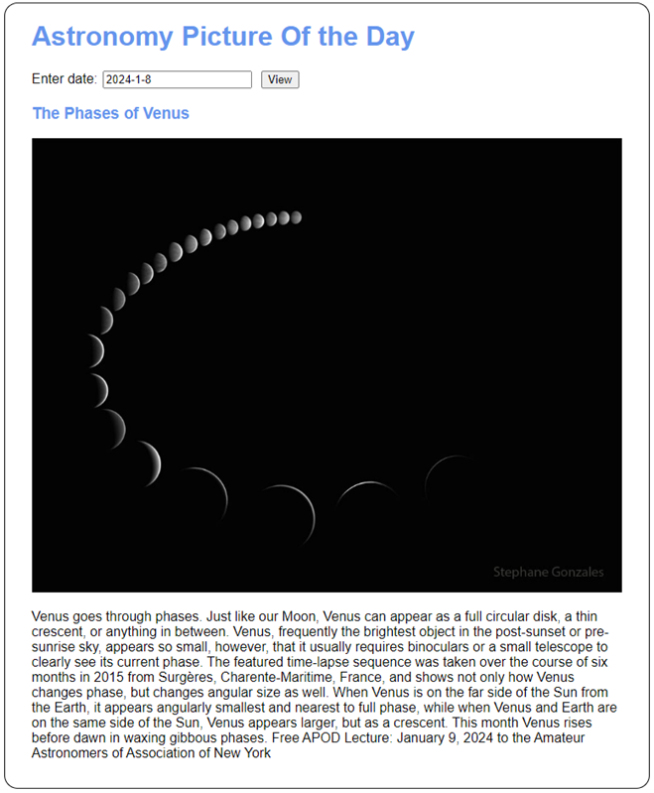
The Astronomy Picture of the Day app

Slide 22
The <body> element for the APOD app
<body>
<h1>Astronomy Picture Of the Day</h1>
<div>
<label for="date">Enter date:</label>
<input type="text" name="date" id="date">
<input type="button" id="view_button"
value="View">
</div>
<div>
<h3 id="title"></h3>
<div id="display"></div>
<p id="explanation"></p>
<p id="msg" class="error"></p>
</div>
<script src="apod.js"></script>
</body>

Slide 23
Some of the CSS for the APOD app
div {
margin-bottom: 1em;
}
label {
display: inline-block;
width: 5em;
}
input {
margin-right: 0.5em;
}
.error {
color: red;
}

Slide 24
The URL for the APOD API
https://api.nasa.gov/planetary/apod
Parameters for the APOD API
Parameter | Description
api_key | An alphanumeric key that identifies the user of this API.
date | The date of the image to retrieve.
Example URL with two parameters
https://api.nasa.gov/planetary/apod?api_key=DEMO_KEY&date =2024-04-22

Slide 25
The JavaScript for the APOD app (part 1)
function getElement(selector) {
return document.querySelector(selector);
}
function getDateString(dt = new Date()) {
return `${dt.getFullYear()}-${dt.getMonth() + 1}-
${dt.getDate()}`;
}
async function getPicture(date) {
const dateString = getDateString(date);
const domain = `https://api.nasa.gov/planetary/apod`;
const request =
`?api_key=DEMO_KEY&date=${dateString}`;
const response = await fetch(domain + request);
return await response.json();
}

Slide 26
The JavaScript for the APOD app (part 2)
function clear() {
getElement("#title").textContent = "";
getElement("#display").textContent = "";
getElement("#explanation").textContent = "";
getElement("#msg").textContent = "";
}
function displayPicture(data) {
if (data.error) { // error
getElement("#msg").textContent =
data.error.message;
}
else if (data.code) { // problem
getElement("#msg").textContent = data.msg;
}
else { // success
// heading
getElement("#title").textContent = data.title;
// image or video
const displayDiv = getElement("#display");

Slide 27
The JavaScript for the APOD app (part 3)
if (data.media_type === "image") {
const img = document.createElement("img");
img.src = data.url;
img.alt = "NASA photo";
img.width = 700;
displayDiv.appendChild(img);
}
else if (data.media_type === "video") {
const iframe =
document.createElement("iframe");
iframe.src = data.url;
iframe.allowFullscreen = true;
iframe.setAttribute("frameborder", "0");
displayDiv.appendChild(iframe);
}
// text
getElement("#explanation").textContent =
data.explanation;
}
}

Slide 28
The JavaScript for the APOD app (part 4)
document.addEventListener("DOMContentLoaded", () => {
// set text box to today's date in YYYY-MM-DD format
const dateTextbox = getElement("#date");
dateTextbox.value = getDateString();
dateTextbox.focus();
getElement("#view_button").addEventListener(
"click", async () => {
clear(); // clear any previous display
const dateString = getElement("#date").value;
const date = new Date(dateString);
if (date.toString() === "Invalid Date") {
const msg = "Please enter a valid date " +
"in YYYY-MM-DD format.";
getElement("#msg").textContent = msg;

Slide 29
The JavaScript for the APOD app (part 5)
} else {
try {
const data = await getPicture(date);
displayPicture(data);
} catch(e) {
getElement("#msg").textContent =
e.message;
}
}
getElement("#date").focus();
});
});

Slide 30
A module that exports an asynchronous function
const url = "https://jsonplaceholder.typicode.com/users";
async function getUsers() {
const response = await fetch(url);
return await response.json();
}
export {getUsers};
Code that imports and uses the function
import {getUsers} from "./mod_example.js";
getElement("#get_users").addEventListener(
"click", async () => {
const users = await getUsers();
for (let user of users) {
console.log(user);
}
});

Slide 31
A module file with a top-level await
const url = "https://jsonplaceholder.typicode.com/users";
// no async function needed
const response = await fetch(url);
const users = await response.json();
export default users;
Code that imports and uses the data from the module
import users from "./mod_example.js";
// no async or await keywords needed
getElement("#get_users").addEventListener("click", () => {
for (let user of users) {
console.log(user);
}
});

Slide 32
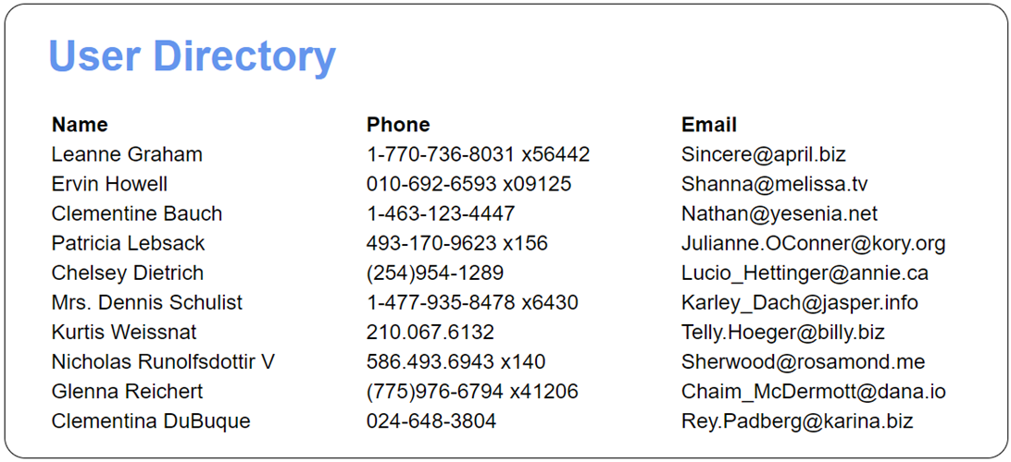
The User Directory app

Slide 33
The <body> element for the User Directory app
<body>
<h1>User Directory</h1>
<table id="users">
<thead>
<tr>
<th width="35%">Name</th>
<th width="35%">Phone</th>
<th width="30%">Email</th>
</tr>
</thead>
<tbody></tbody>
</table>
<script src="mod_users.js" type="module"></script>
<script src="user_directory.js" type="module">
</script>
</body>

Slide 34
Some of the CSS for the User Directory app
tr {
text-align: left;
}

Slide 35
The mod_users.js file
const url = "https://jsonplaceholder.typicode.com/users";
// async not required because this is a module
const response = await fetch(url);
const users = await response.json();
export default users;

Slide 36
The user.directory.js file
import users from "./mod_users.js";
const tbody = document.querySelector("#users tbody");
for (let user of users) {
const tr = document.createElement("tr");
const td1 = document.createElement("td");
td1.appendChild(document.createTextNode(user.name));
tr.appendChild(td1);
const td2 = document.createElement("td");
td2.appendChild(document.createTextNode(user.phone));
tr.appendChild(td2);
const td3 = document.createElement("td");
td3.appendChild(document.createTextNode(user.email));
tr.appendChild(td3);
tbody.appendChild(tr);
}

Slide 37
A CORS error in the console
A CORS header that allows a specific cross-origin request
Access-Control-Allow-Origin: https://example.com
A CORS header that allows any cross-origin request
Access-Control-Allow-Origin: *

Slide 38
Ways to make a cross-origin request to an API that doesn’t allow them
Use a third-party, server-side proxy (only recommended for prototyping and testing).
Create your own server-side proxy.
The URL for a third-party proxy named CORS Anywhere
https://cors-anywhere.herokuapp.com/
How to temporarily enable the CORS Anywhere proxy
Navigate to the above URL in the browser you want to use.
Click on the Request temporary access to the demo server button.

Slide 39
Code that uses the CORS Anywhere proxy to make a cross-origin request
const proxy = "https://cors-anywhere.herokuapp.com/";
const api =
"https://www.flickr.com/services/feeds/photos_public.gne";
const url = proxy + api; // prefix api URL with CORS
// Anywhere URL
const response = await fetch(url);
...

